Slide 1
Delft Blue Tutorial
For machine learning / scikit with conda
Tom Viering

Slide 2
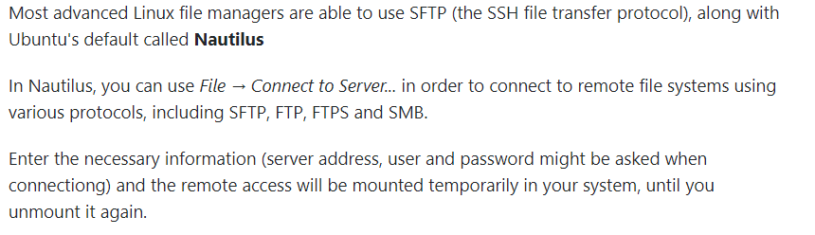
SSH & FileTransfer tools
Mac: Core Shell https://codinn.com/shell/
Windows: MobaXTerm https://mobaxterm.mobatek.net/
Linux: everything can be done within your OS already
Terminal: use ssh command (first ssh to student-linux, then ssh to Delft Blue)
You can use the GUI of your OS to transfer files :

Slide 3
In the following
Sometimes, there will be my netid, you will have to change it to your own!

Slide 4
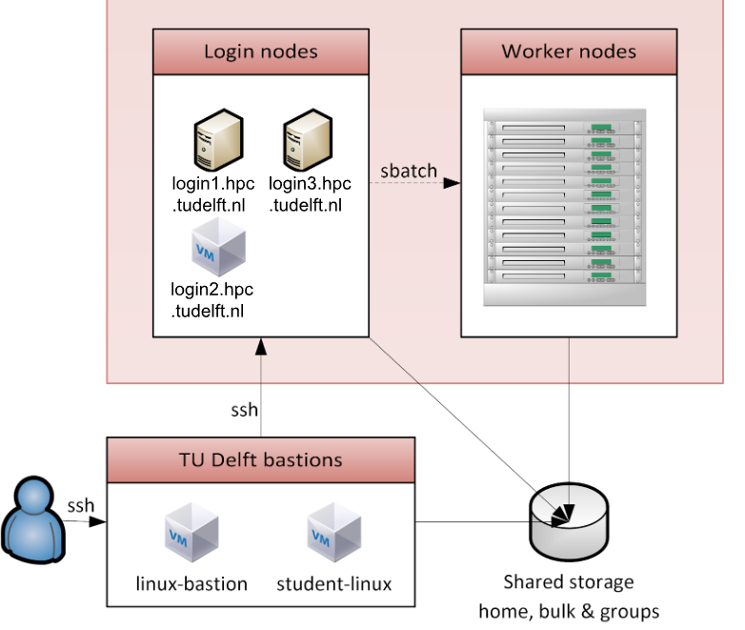
How to connect
Set up an SSH tunnel
linux-bastion.tudelft.nl for staff
student-linux.tudelft.nl for students

Slide 5
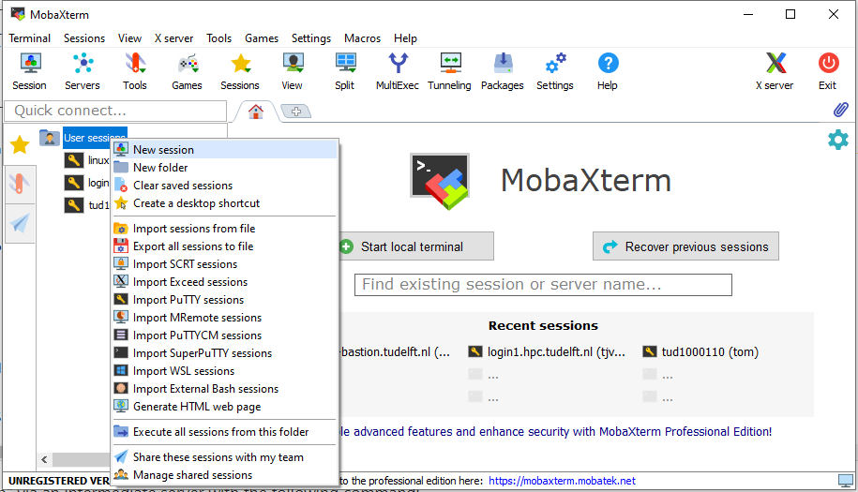
Make new session

Slide 6
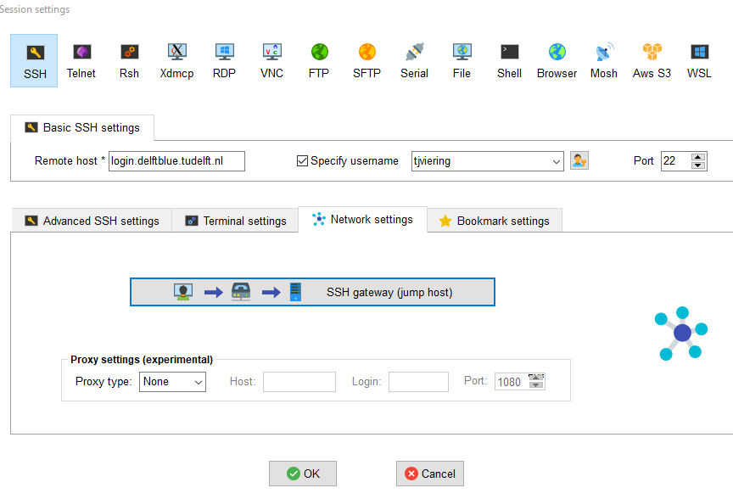
Fill out the info

Slide 7
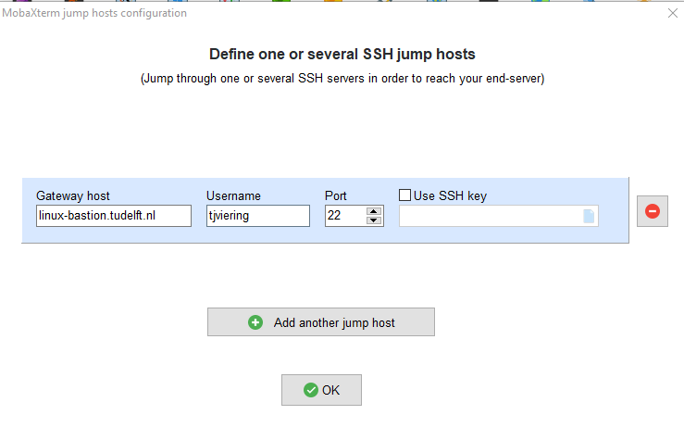
Set up the gateway (tunnel)
student-linux.tudelft.nl for students

Slide 8
This may take a while and may ask for a password (its testing the connection)
For your sanity: I suggest to let MobaXterm remember the passwords

Slide 9
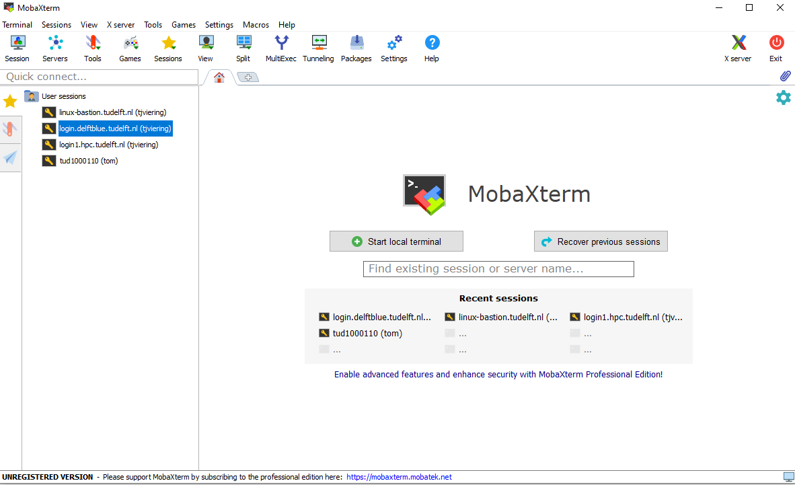
Start new session
Double click to connect (opens in a new tab)

Slide 10
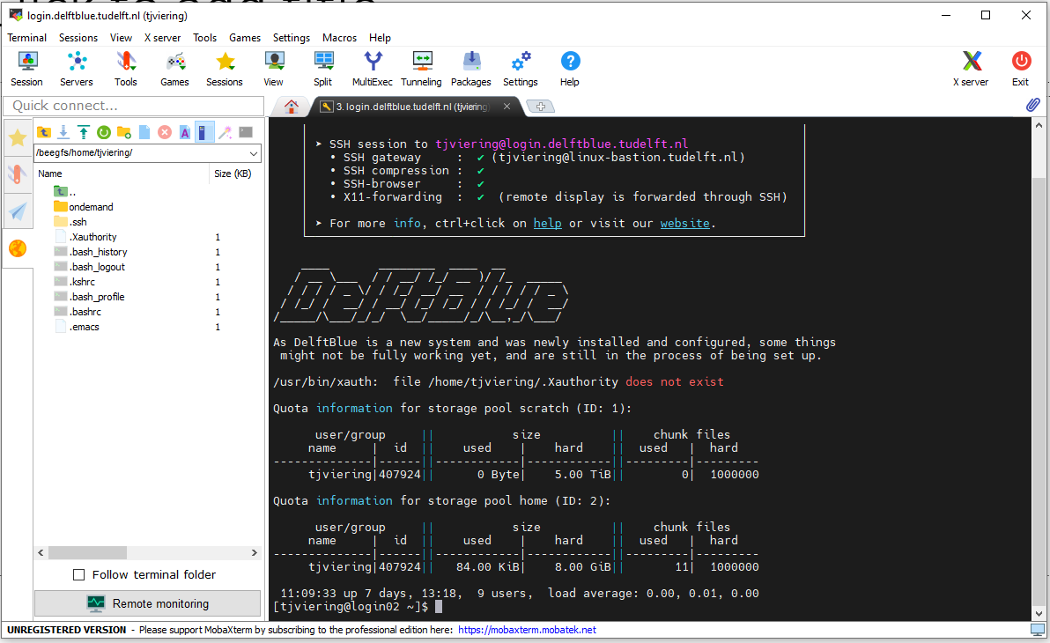
Connected, hooray!

Slide 11
Important directories
/beegfs/home/tjviering/
home dir (8GB space, backed up)
Use it to store your code, python environment, etc. small files!!!
/beegfs/scratch/tjviering/
Extremely fast and large storage (5TB per user)
Use for storing datasets, results, etc.
Not backed up: once in a while everything is deleted (last time May 5th)! They will warn you via Mattermost DHPC channel
As soon as your experiment is done, transfer the files to your home directory or laptop to make sure you don’t loose them.

Slide 12
Xterm interface
File explorer
Use for uploading, downloading, moving, etc. of files and folders
Current directory
Terminal
Used for running commands

Slide 13
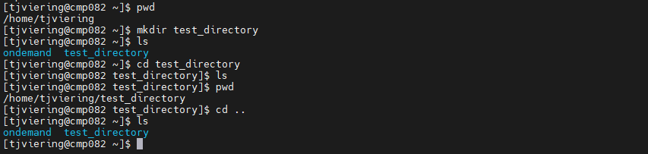
Navigating using the commandline
pwd: displays the current directory of the shell
mkdir: makes new directory
ls: displays what is in the current directory
cd: navigate to a directory (“cd ..” moves to the parent directory)
exit: closes the connection to this server (useful in interactive job)

Slide 14

Debugging your code
Run this to start an interactive session:
srun --cpus-per-task=40 --time=01:00:00 --mem=100G --pty bash
This will start a job of 30 minutes in the cluster with 2G mem
We can use it to debug our code on the cluster and make sure everything works before we do a real big experiment!
Before I was in the login02 node (this node is used to submit jobs)
Now I am in a compute node (cmp082 in this case, depends on what is available)
The command “hostname” will also tell you in which node you currently are

Slide 15
Show time left
Run this to show how much time is left in your interactive job:
export PS1="$PS1 \$(squeue -h -j $SLURM_JOBID -o %L)"
If the time is up, your job is killed
If you exceed the memory, your job may be killed (or the program will be killed that required too much memory)

Slide 16
Loading pre-installed software
There is already a lot of software available on DelftBlue
We will only install what is not already available (!)
Execute this:
module load 2022r1
module avail
module load compute
module load miniconda3
Load DelftBlue software stack
Shows what is available
I will use conda to manage my python environment. You can also use pip or load preinstalled modules directly (e.g. py-numpy), but the 2022r1 don’t have pandas….

Slide 17
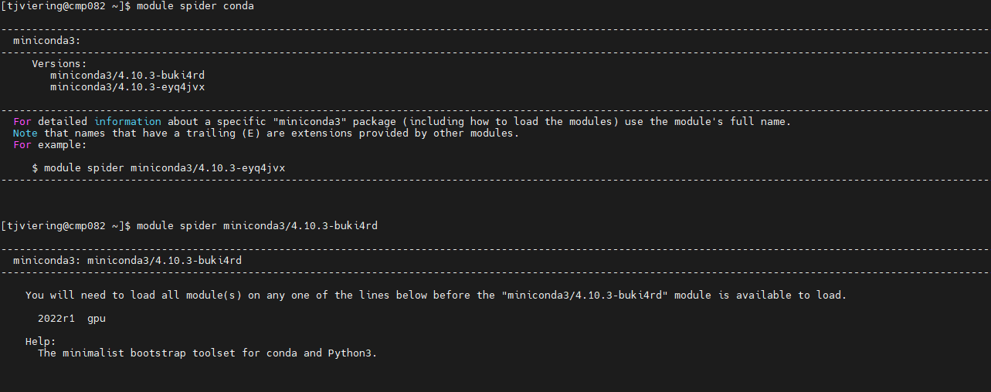
Finding software
module spider conda
Searches for the module “conda” and displays the search result

Slide 18
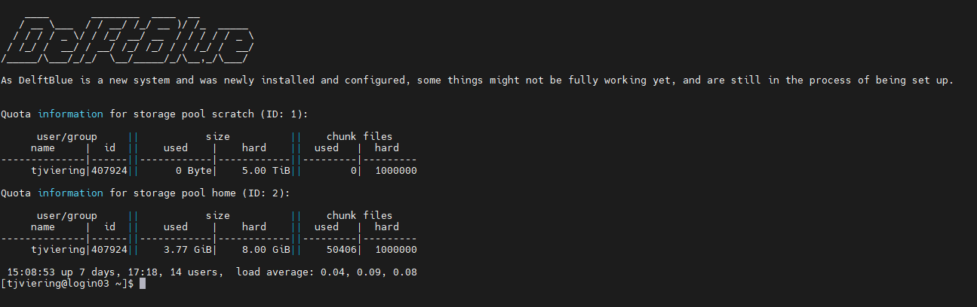
Warning: disk space.
Be careful: by default, Conda installs stuff to your home directory. This directory has a hard limit of 8GB of space.
If you get errors and don’t know why, check how much space is left.
At login, its displayed how much space there is left in your homedir:
Scratch space
Homedir

Slide 19
Create the environment
You need to load conda first, then you can create your environment:
(You can do this on a login node also! Maybe more convenient, because it can be time consuming!)
conda create -n myenv python=3.9 scikit-learn pandas=1.4.1 tqdm numpy scipy
Do not interrupt Conda with CTRL+C, otherwise it may corrupt some files…
Make sure you do not make an environment with the same name that already exists in your Conda installation, this may lead to problems… (conda info --envs)
I don’t know if this is because DelftBlue is new, but I had to rerun this command a few times to get stuff working. I got some strange errors about failing to link packages, and it had to redownload packages a few times (got corrupted during download?). So be patient ☺
I use this, because on my laptop I use this pandas version. They need to be the same, otherwise, you cannot load the pickle files from the server.

Slide 20
Checking environment 1/2
First, you need this piece of code to activate conda:
unset CONDA_SHLVL
source "$(conda info --base)/etc/profile.d/conda.sh"
Now, you can activate the environment:
conda activate myenv5
After activating, you will see that the environment is active because your commandline starts with (myenv5):
(myenv5) [tjviering@cmp081 zh_CN]$

Slide 21
Checking environment 2/2
Now let us check if all packages can be imported in Python:
[tjviering@cmp081 zh_CN]$ module load compute
[tjviering@cmp081 zh_CN]$ module load miniconda3
[tjviering@cmp081 zh_CN]$ unset CONDA_SHLVL
[tjviering@cmp081 zh_CN]$ source "$(conda info --base)/etc/profile.d/conda.sh"
[tjviering@cmp081 zh_CN]$ conda activate myenv5
(myenv5) [tjviering@cmp081 zh_CN]$ python
Python 3.9.12 (main, Apr 5 2022, 06:56:58)
[GCC 7.5.0] :: Anaconda, Inc. on linux
Type "help", "copyright", "credits" or "license" for more information.
>>> import scipy as sp
>>> import scipy.optimize
>>> import numpy as np
>>> import pandas as pd
>>> from tqdm import tqdm
>>> import argparse
>>> from hashlib import sha256
>>> exit()
We get no errors, it works! ☺

Slide 22
Upload your scripts and data
You do heavy computations on the cluster via jobfiles.
(Never run heavy computations on the login node!!!)
First, I put my code in the scratch directory:
/beegfs/scratch/tjviering/
I put the following files there from our github:
fit_database.py
database-accuracy.csv
The csv file can be found in:
lcdb/python/lcdb/database.tar.7z

Slide 23
Example jobfile
Upload this example jobfile to “testjob.sh” in scratch:
#!/bin/sh
#SBATCH --job-name="lcfit_test"
#SBATCH --partition=compute
#SBATCH --time=01:00:00
#SBATCH --ntasks=1
#SBATCH --cpus-per-task=1
#SBATCH --mem-per-cpu=512
#SBATCH --output=lcfit0.txt
#SBATCH --error=lcfit0.txt
module load 2022r1
module load compute
module load miniconda3
unset CONDA_SHLVL
source "$(conda info --base)/etc/profile.d/conda.sh"
conda activate myenv5
cd /beegfs/scratch/tjviering/
srun python fit_database.py 0
Jobname
This partition only uses CPU (fine for our project!)
1 hour requested (max = 24 hours)
I only use 1 core, for multicore jobs see here
512 MB requested (for GB type 10G for example)
Where to write the output and errors of this script
Load preinstalled software
Activate conda environment
Go to the right directory
Run the 0th part of fitting the database
Use srun for a heavy computation (this will collect runtime statistics such as memory used, etc.)

Slide 24
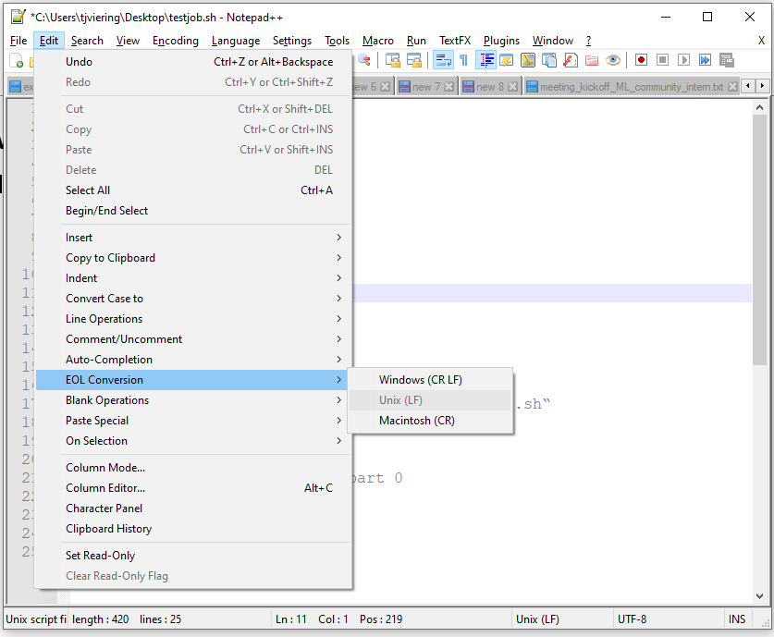
On Windows
If you use a Windows editor to create jobfiles, this will lead to problems on the cluster, because you may use DOS linebreaks
Use Notepad++ and fix it:
Convert line endings before you upload
Edit -> EOL Conversion -> Unix (LF)
Save & upload

Slide 25
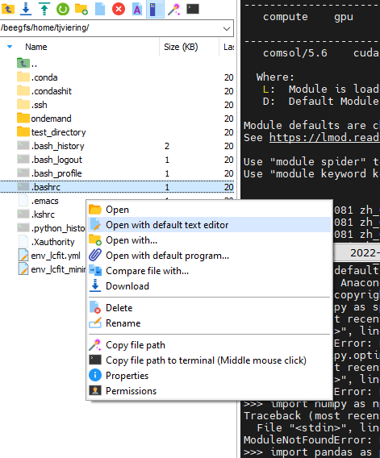
Useful aliases 1/2
Open the file /beegfs/home/tjviering/.bashrc

Slide 26
Useful aliases 2/2
At the top, add the following lines:
alias st='sacct --format=JobID,JobName%30,State,Elapsed,Timelimit,AllocNodes,Priority,Start,NodeList'
alias sq='squeue -u tjviering --start'
alias sq2='squeue -u tjviering --start --format
=JobName%30'
If you click File->Save, or CTRL-S, the editor will ask you whether to update the file on the cluster, click Yes.
In the terminal, run source ~/.bashrc
Now you can use st, sq, sq2 commands in the terminal

Slide 27
Overview of SLURM commands
sbatch jobfile.sh Submits jobfile.sh job to SLURM. You can only do this from the login node (check hostname)
SLURM will put the jobs in a queue, until there is a spot for your job to run. You can see why it is in the queue by running:
sq List of jobs in the queue (use squeue to see other peoples job also)
st Overview of your jobs (incl. queue, finished, killed, etc.)
scancel Use this to cancel jobs
e.g. -u tjviering to cancel all of your jobs (replace netid), or you can cancel a specific job with scancel jobid. Find the jobid from st. You may need this if you find a bug in your code or jobfile.

Slide 28
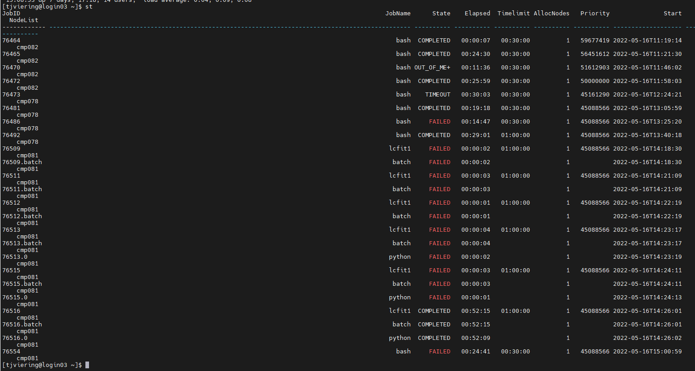
st output
The higher your priority, the sooner your jobs will run. The more you use the cluster, the lower your priority.

Slide 29
Exercise
Try to get the testjob.sh (provided in previous slides) to run correctly. This will fit a part of the learning curve database.
Make sure everything goes correctly by using the commands st, sq, and checking the output file
Use cat lcfit0.txt to dump the output of the output file to your terminal.
Use tail –f lcfit0.txt for automatically updating view of the latest changes to the file (CTRL + C to quit)

Slide 30
Debugging code with interactive session
You can also start an interactive session and paste this into it to check if the code is working:
module load 2022r1
module load compute
module load miniconda3
unset CONDA_SHLVL
source "$(conda info --base)/etc/profile.d/conda.sh"
conda activate myenv5
cd /beegfs/scratch/tjviering/
python fit_database.py 0
However, you can only have 1 interactive session at a time! And maximum 1 hr. So, better to use real jobs for real experiments!

Slide 31
The real work
Note that I split the whole database in 13 parts (see also fit_database.py main() function), so that each part approximately takes 1 hr.
When I want to recompute the whole database, I make 13 jobscripts, each doing a different part. Then I submit all 13 jobscripts at the same time. If I have a high priority, I get all my results in 1-2 hours ☺!
To make the jobscripts, I have a small piece of code (see next slides)

Slide 32
Generating jobfiles
Generates 10 jobfiles
Does it directly right for linux!
for part in range(0,10):
f = open("job%d.sh" % part, "w", newline='\n')
f.write("#!/bin/sh\n")
f.write("#SBATCH --time=02:00:00\n")
f.write("#SBATCH --mincpus=2\n")
f.write("#SBATCH --job-name=lc%d\n" % part)
f.write("#SBATCH --output=lcfit%d.txt\n" % part)
… (see example jobfile from before)
f.write("srun python fit2.py %d\n" % part)
f.close()
Jobname, output, etc. depends on part
Be sure to tell python which part to do

Slide 33
Generating sbatch commands
I use this piece of code to generate the sbatch commands:
for part in range(0,10):
print('sbatch job%d.sh' % part)
I run this locally on my laptop, and copy the results, and paste them in XTerm.

Slide 34
Typical workflow
For the fit_database.py I told you 1 hr + 512 MB is enough. For your own code this may not be the case… You will have to test it before you submit!
Do like I do:
Split the database in parts
Check how much time is necessary for 1 part (maybe take the largest or most time consuming part!). You can check this easily by using an interactive job.
Use this single part to estimate the time, memory required for all jobs. Be sure to request just a little bit more (20% margin or so), otherwise, if your job may get killed…
Generate the jobfiles and sbatch commands
Submit them all to the cluster at the same time
Make sure your code on the cluster is up to date before you submit!
Don’t forget to transfer your results file away from scratch, so you don’t loose them! For example, transfer to your laptop.

Slide 35
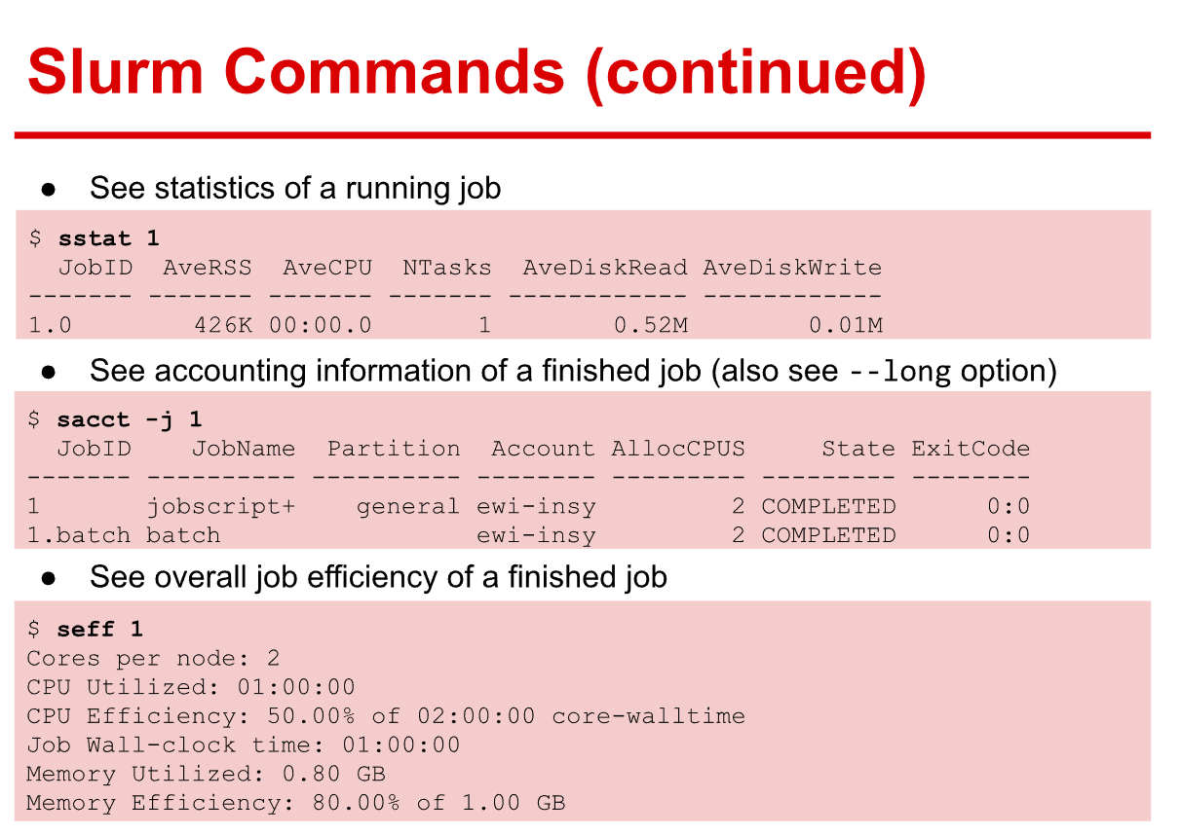
Check efficiency

Slide 36
Tips
Don’t be scared to submit jobs to the cluster ☺
You can learn via trail and error!
The DelftBlue is only in beta phase now

Slide 37
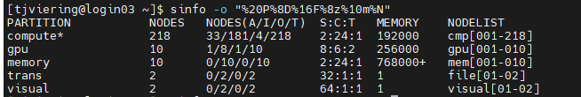
How busy is it?
sinfo -o "%20P%8D%16F%8z%10m%N"
A: Allocated
I: IDLE (Free for use!!!) O: Other
T: total

Slide 38
APPENDIX

Slide 39
More information
https://gitlab.tudelft.nl/dhpc/docs/-/wikis/Frequently-Asked-Questions
https://gitlab.tudelft.nl/dhpc/docs/-/wikis/home
https://gitlab.tudelft.nl/dhpc/docs/-/wikis/Python
https://gitlab.tudelft.nl/dhpc/docs/-/wikis/Remote-access-to-DelftBlue#dont-forget-either-eduvpn-or-linux-bastion
https://gitlab.tudelft.nl/dhpc/docs/-/wikis/Data-transfer-to-DelftBlue#4-network-drives
https://gitlab.tudelft.nl/dhpc/docs/-/wikis/DHPC-modules
https://gitlab.tudelft.nl/dhpc/docs/-/wikis/Slurm-scheduler#job-submission-and-control-using-slurm
You can also ask in the Mattermost channel: Mattermost DHPC channel

Slide 40
Conda space
conda clean -all
This cleans up your conda cache freeing up some space

Slide 41
If you run out of space with Conda….
You can store Conda stuff on the scratch directory. But only do this if really necessary!
Scratch will get removed now and then… So this is why I use the home directory.
Do the following steps if you want to store your Conda stuff on scratch:
mkdir -p /scratch/${USER}/.conda
Move all files from ~/.conda to /scratch/${USER}/.conda using the mv or rsync command
Link the folders:
ln -s /scratch/${USER}/.conda $HOME/.conda
Now when you open ~/.conda, actually, the scratch directory is used

